Slide 1
AS91896[2.7] AS91887[2.8] Documentation
[Peter McKay]

Slide 2
[Monster_Cards_Internal]
Link to GitHub Repository:
[https://github.com/peter123321123321/Monster-Cards-Internal]
Links to Trello board / project management tools:
[https://trello.com/b/HvmDrkWJ/monstercardsinternal]
Link to final version of your program:
[]
Ensure you have made these links ‘public’ so that they are open to anyone, including the marker. The link to your program is the final outcome of this whole project – your finished program.

Slide 3
Explain relevant Implications:
Additional rows can be added by clicking in the last cell and then using the Tab key
Relevant implication | Explain the implication and say how it is relevant to this project
Usability | Usability is about making the program as easy to use as possible for the largest number of users. It considers things like are instructions clear so that the user can avoid and correct errors, and does it tell the user what is currently happening. It is important to minimize or eliminate frustration by eliminating the things that could cause frustration.
Functionality | Functionality is making sure that the outcome works as intended. It should work for expected, unexpected, and boundary cases. For example, if the user is asked to input yes or no when asked a question. Along with expected cases, e.g., yes or no it. It should also works as intended If the user inputs unexpected cases, e.g., maybe or 1234. Another part of functionality is making the code as efficient as possible. This can be done by breaking large code problems into multiple subproblems.
Notes:
Additional rows can be added by clicking in the last cell and then using the Tab key

Slide 4
Explain relevant Implications:
Additional rows can be added by clicking in the last cell and then using the Tab key
Relevant implication | Explain the implication and say how it is relevant to this project
Future proofing | As technology develops digital systems and programs will quickly become obsolete or inefficient which is why its important to future proof your project to make sure its easy to edit, change and improve in the case it needs to be. You can do this by annotating your code (writing down what each part of the program does). Splitting the program into smaller functions that can be edited easily without affecting the entire program and many others
Aesthetics | Aesthetics is the overall look of the program and making the outcome pleasing to look at/use. A program with proper spacing prompts and decoration will be more aesthetic than one without and be easier for a user to navigate. when thinking about aesthetics you should consider things like, Is it well laid out, Does it follow design conventions, does it reduce unused information. So that it has a cleaner look.
Notes:
Additional rows can be added by clicking in the last cell and then using the Tab key

Slide 5
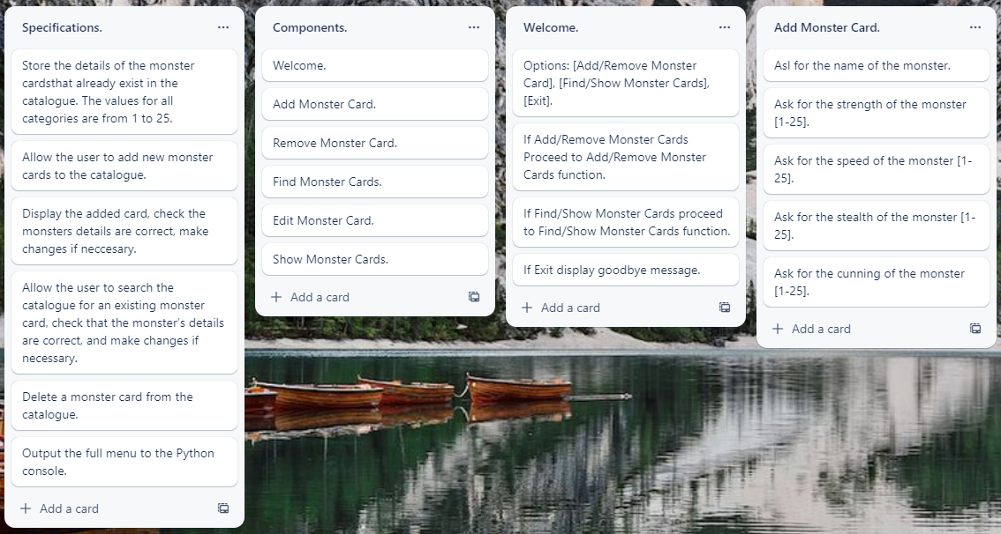
Decomposition:
Paste screenshots of your initial Trello board / task decomposition on this slide. If you have a long list, you might need to break it up into several slides.
Notes:
Paste screenshots of your initial Trello board / task decomposition on this slide. If you have a long list, you might need to break it up into several slides.

Slide 6
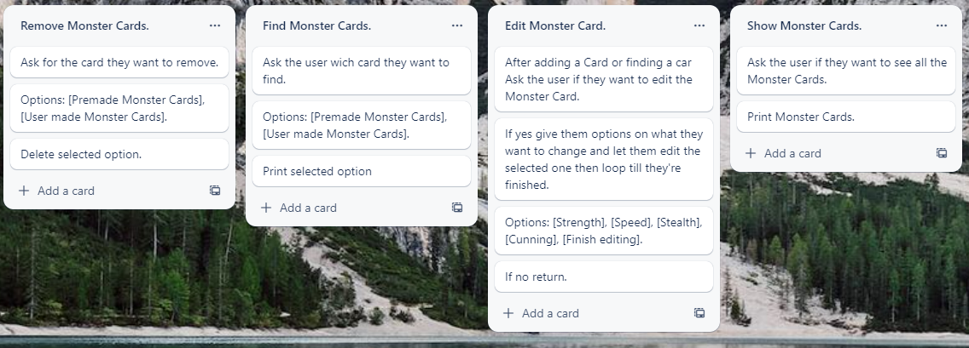
Decomposition:
Paste screenshots of your initial Trello board / task decomposition on this slide. If you have a long list, you might need to break it up into several slides.
Notes:
Paste screenshots of your initial Trello board / task decomposition on this slide. If you have a long list, you might need to break it up into several slides.

Slide 7
[Component name] (Trello screenshot)

Slide 8
[Component name] - Test Plan
Additional rows can be added by clicking in the last cell and then using the Tab key
Test Cases - input | Expected output
Notes:
Additional rows can be added by clicking in the last cell and then using the Tab key

Slide 9
[Component name]: Testing
You must show the results of testing. For each component, include a screenshot proving it works. You can also include notes about each test.
Notes:
You must show the results of testing. For each component, include a screenshot proving it works. You can also include notes about each test.

Slide 10
[Component name]: Trialling
NOTE: Trialling needs to happen for at least 2 of your components but is not necessary for ALL components.
Trialling is not the same as testing. Trialling is about finding different ways of building the same component. Show evidence of your trialling here. Select one of your trials for further development and give reasons for your choice.
Notes:
NOTE: Trialling needs to happen for at least 2 of your components but is not necessary for ALL components.
Trialling is not the same as testing. Trialling is about finding different ways of building the same component. Show evidence of your trialling here. Select one of your trials for further development and give reasons for your choice.

Slide 11
Assembled Outcome Testing:
Show testing for your assembled outcome below. This should include a test plan followed by screenshot proof.
Notes:
Show testing for your assembled outcome below. This should include a test plan followed by screenshot proof.

Slide 12
Address relevant Implications:
Relevant implication | Explain how your final outcome addresses each implication

Slide 13
Version Control Evidence:
Your version control evidence should go here. This could be in the form of screenshots (both of your GitHub repository as well as your local project folder) as evidence of your incremental development.
Notes:
Your version control evidence should go here. This could be in the form of screenshots (both of your GitHub repository as well as your local project folder) as evidence of your incremental development.

Slide 14
Final Discussion:
Discuss how the information from planning, testing and trialling of components assisted in the development of a high-quality outcome.
Notes:
Discuss how the information from planning, testing and trialling of components assisted in the development of a high-quality outcome.

